Slide 1
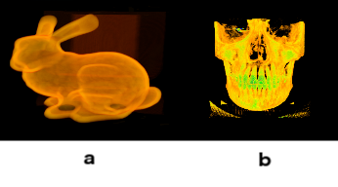
PRISM
A Volume Visualization Tool
Randall Reese

Slide 2
PRISM: Progressive Resolution for Imaging and Storage Management
PRISM is a framework for rendering high scale volumetric data.
This tool was developed by the following people, under the support of Idaho National Laboratory:
James Money
Marko Sterbentz
Nathan Morrical
Landon Woolley
Thomas Szewczyk
Randall Reese
Current point of contact is Thomas Szewczyk (thomas.szewczyk@inl.gov)

Slide 3
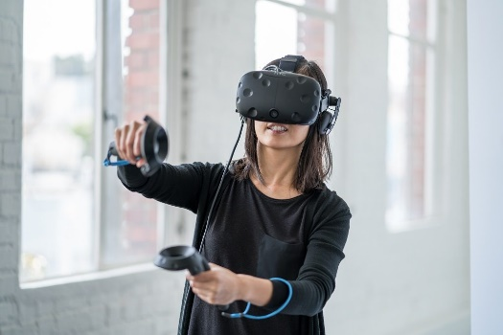

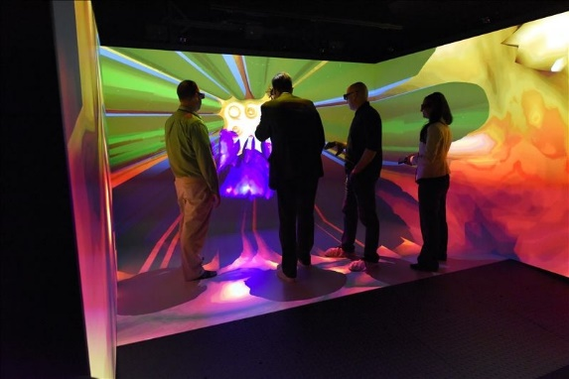

Use of Unity 3D game engine
PRISM is based in the Unity 3D game engine.
By using a commodity game engine, one can utilize PRISM on a large variety of platforms:
Desktop computers
Virtual reality headsets
Smart phones
Cave Automatic Virtual Environment (CAVE)

Slide 4
Hierarchical Z-Ordering
Volumes are taken as a collection of voxels.
Given a volume to be rendered, we divide each volume into a collection of cubes (“bricks”).
Each brick has edge length a power of 2.
E.g. 256 x 256 x 256 voxels.
Different bricks can have different edge lengths.
By ordering the voxels of each brick in a hierarchical Z-order Morton curve (a type of space filling curve), we can control the rendered level of detail for each brick. (See next slide)

Slide 5
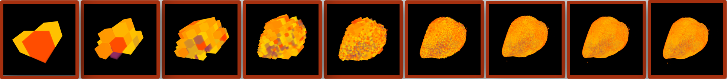
Increasing Z-Level: Sheep Heart.
Z = 0 Z = 1 Z = 2 Z = 3 Z = 4 Z = 5 Z = 6 Z = 7 Z = 8
As Z-level increases, the level of detail also increases.
This allows the user to cull the level of detail as desired.
Sometimes less than “full” level of detail is sufficient.
This decreases the amount of necessary data and render time.

Slide 6
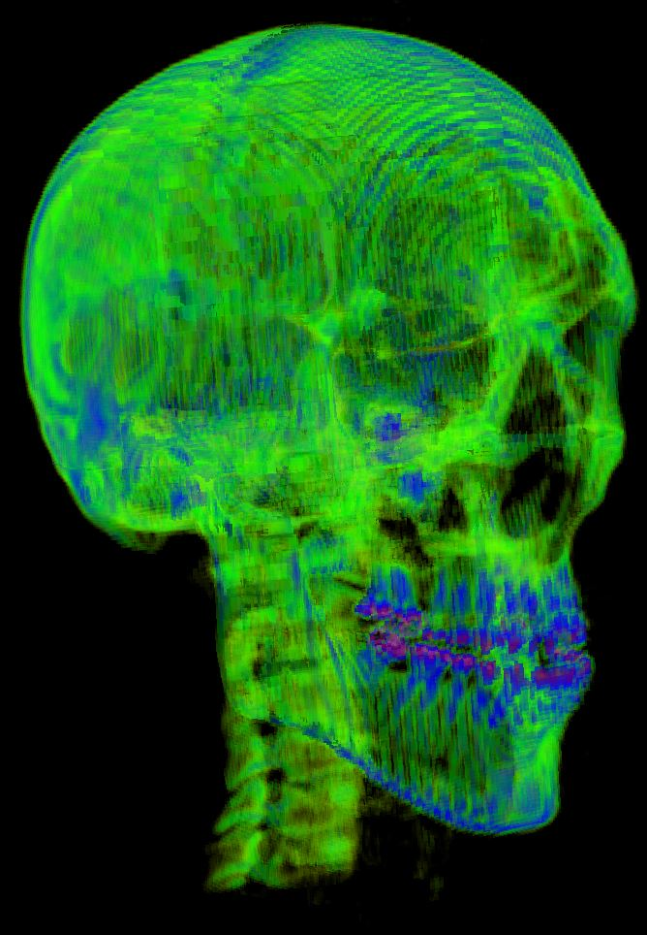
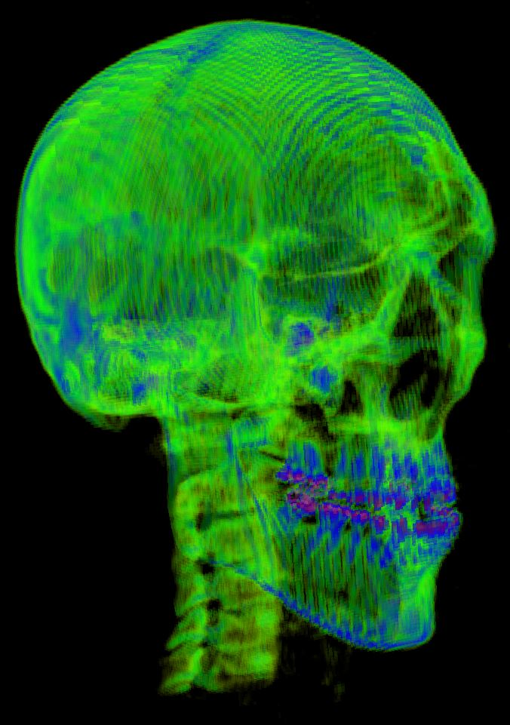
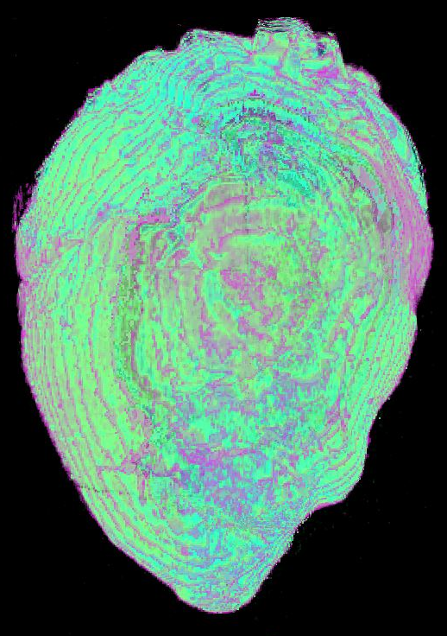
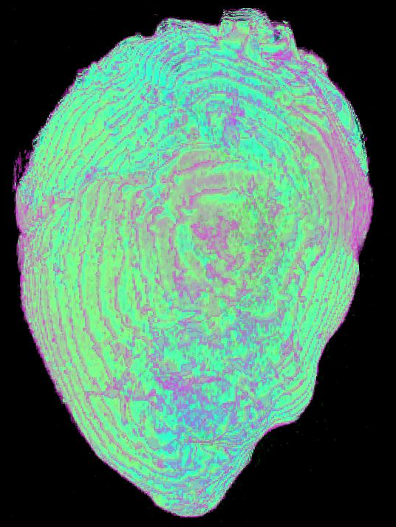
Visibility-based Level of Detail Culling
We can cull the level of detail of individual bricks or voxels based on their visibility relative to the camera by reducing the Z-level of occluded bricks.
This can exponentially reduce the amount of data that must be displayed without noticeably reducing the image quality.
Culled (left) and non-culled (right) skull volume.
Culled (left) and non-culled (right) sheep heart volume.

Slide 7
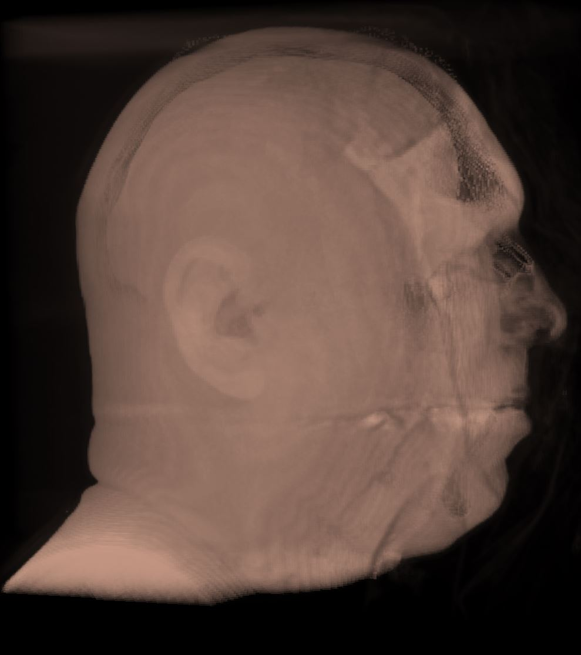
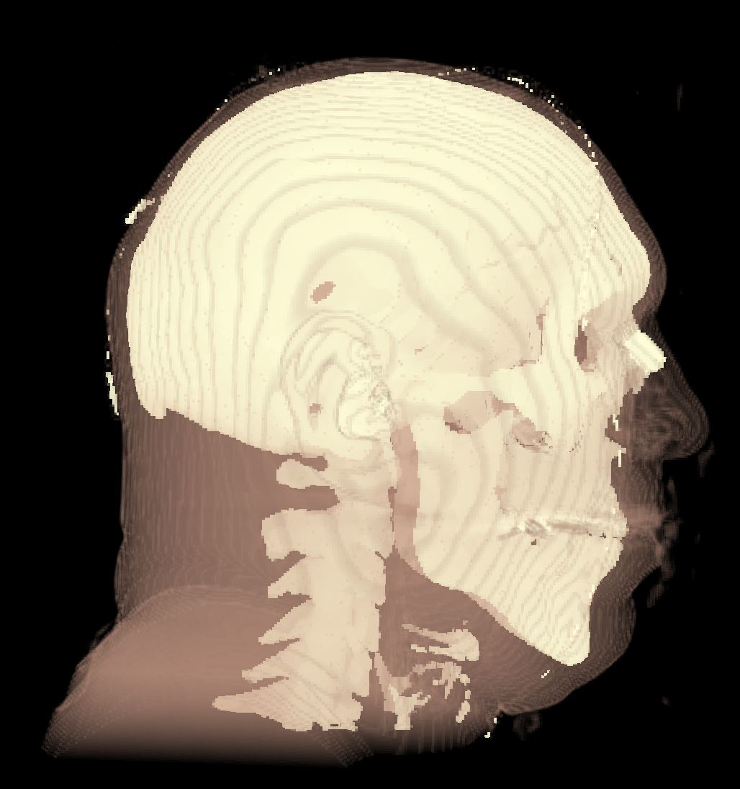
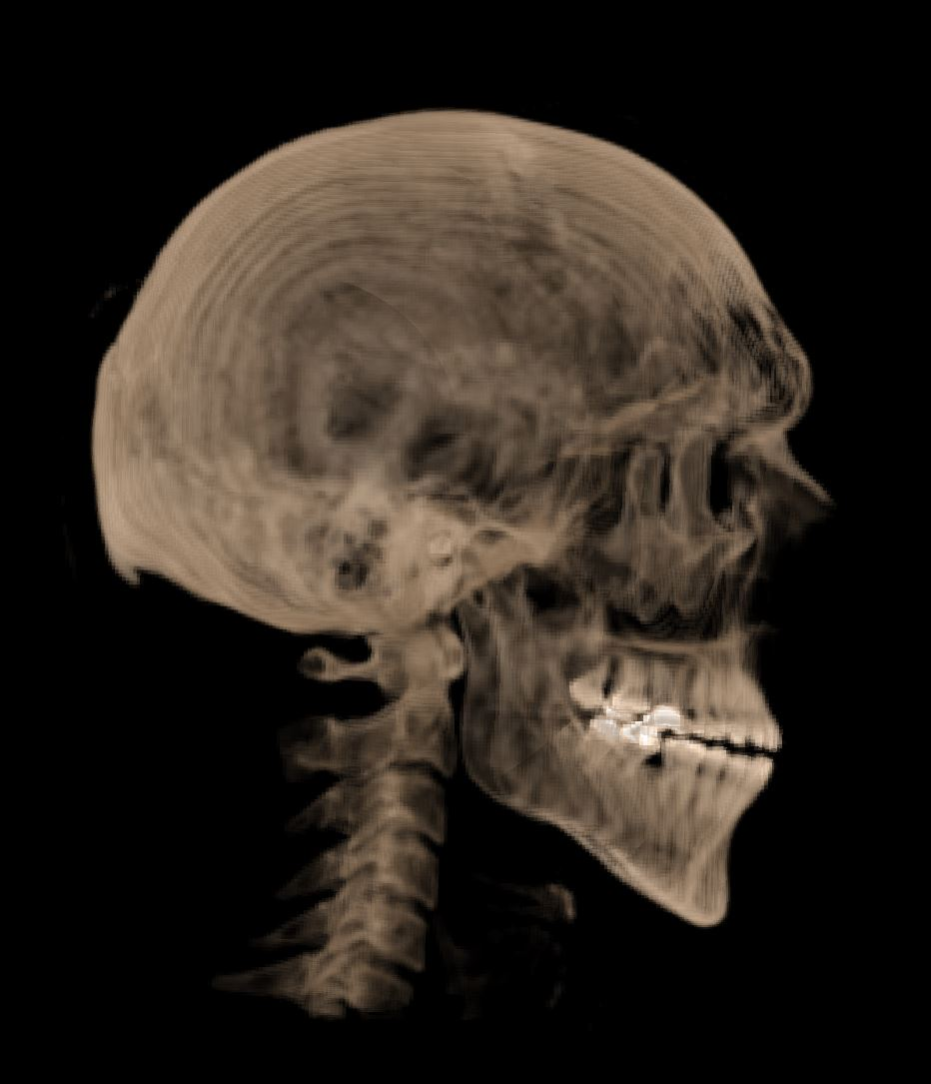
Revealing Isolayers
Using the transfer function manipulation capabilities of PRISM, we can reveal different isolayers of the volume in question:
Three isolayers of the Visible Male (left to right): [1] Skin [2] Skull in skin [3] Skull

